Slide 1
Computer Organization and Assembly Language
Week-01

Slide 2
Logistics
Instructor: Muhammad Usama
Email: m.usama@nu.edu.pk
Office:
Office Hours: Monday (09 am to 12 PM)
Lectures: 2 Lectures/week
Lab: 01 Credit
Grading Policy:
Assignments: 10%
Quizes: 20%
Mid-term exams: 25% (10 + 15)
CP: 5%
Final exam: 40%

Slide 3
Few more logistics
Please submit the assignments on time.
Quizes will be announced
All university policies are applicable and takes pracidence.
Reading material: (Soft copies of the material will be released before/after the class)
The elements of computing systems by Noam Nisam and Shimon Schocken 2nd Edition.
x86 Assembly language by Kip Irvin (Latest Edition)
Assemblay Language Notes by Belal Muhammad Hashmi and Junaid Haroon
System on Chip (SoC) Material from various sources

Slide 4
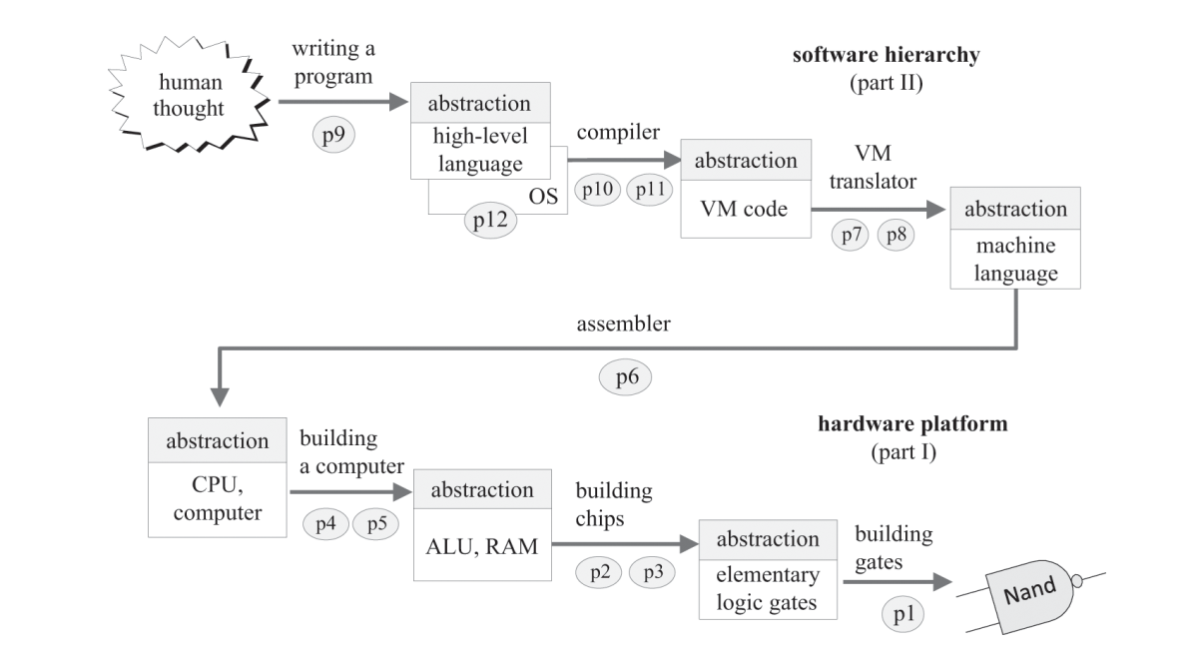
Problem solving on a computer

Slide 5
Review of the CLD course

Slide 6
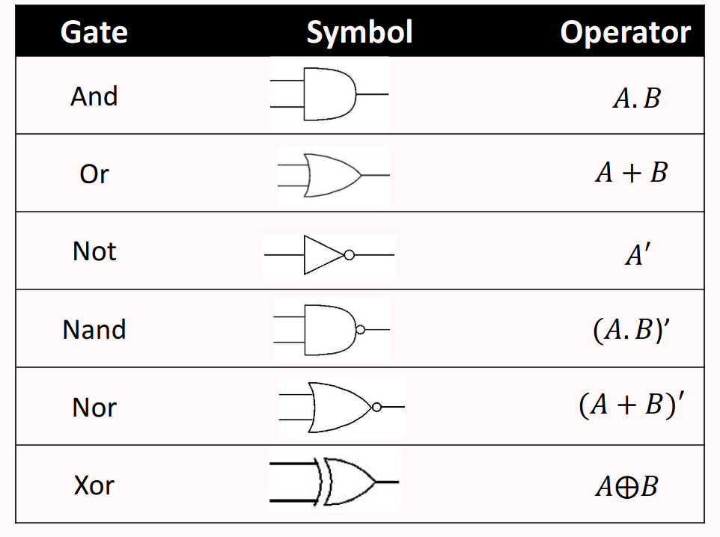
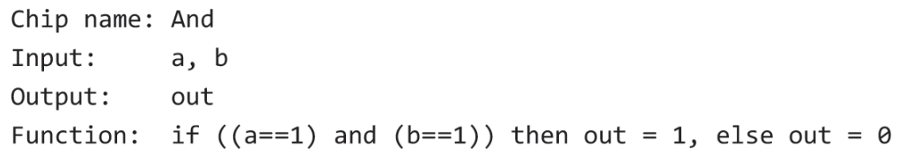
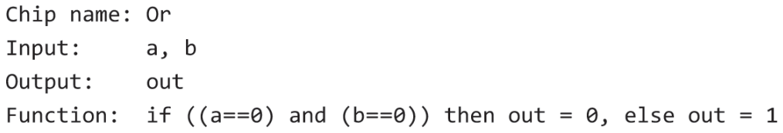
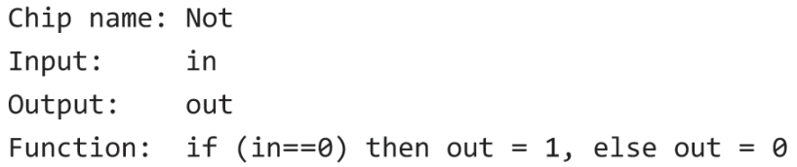
Boolean Logic

Slide 7
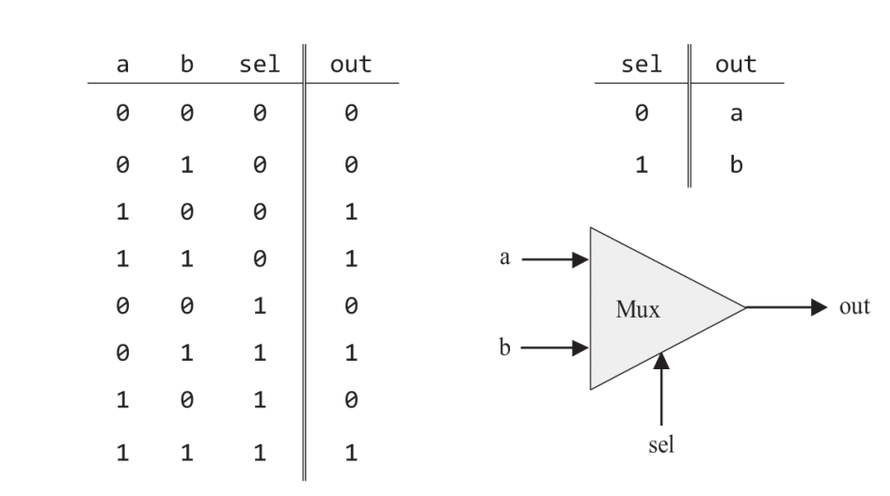
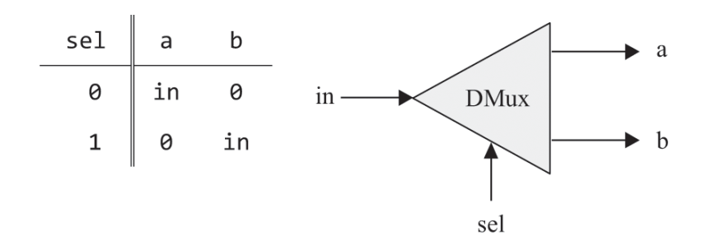
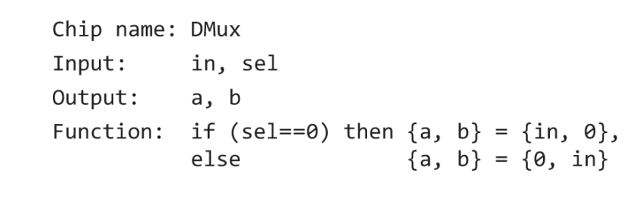
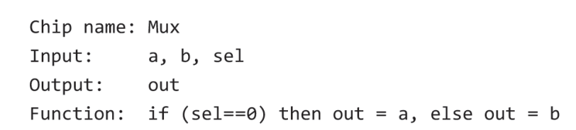
Boolean Logic

Slide 8
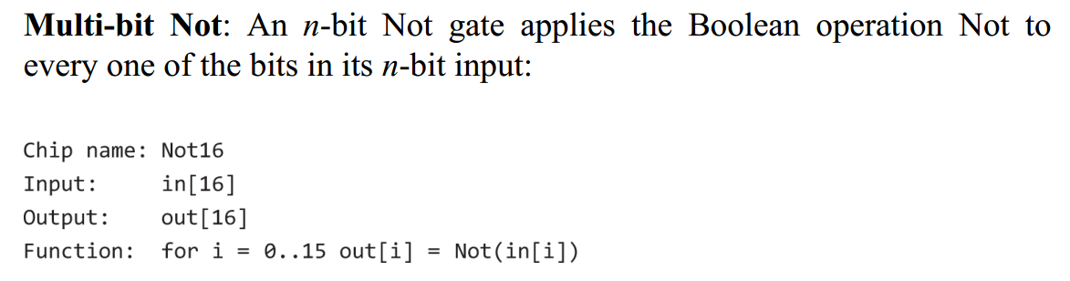
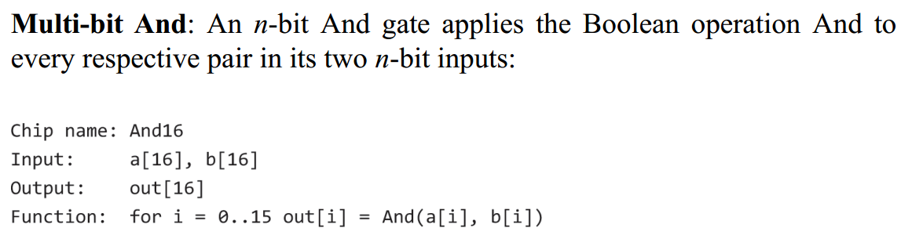
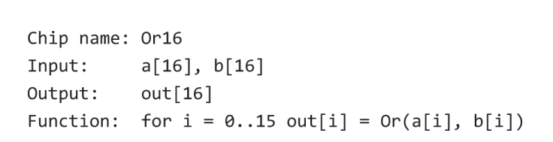
Boolean Logic
Tasks:
Read the reading material on Boolean Logic.
Think of how Multipleway Multiplexers and demux can be written in high-level escriptive language.

Slide 9
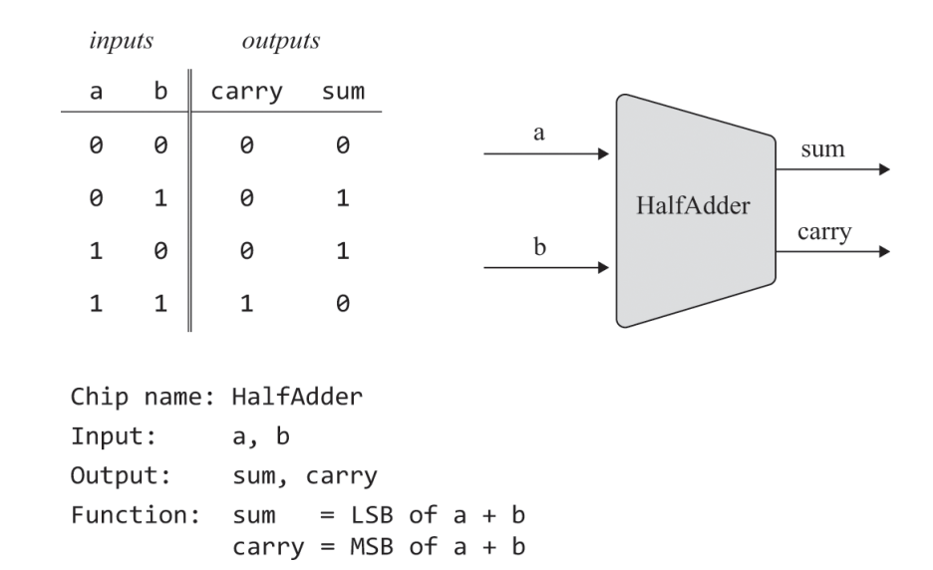
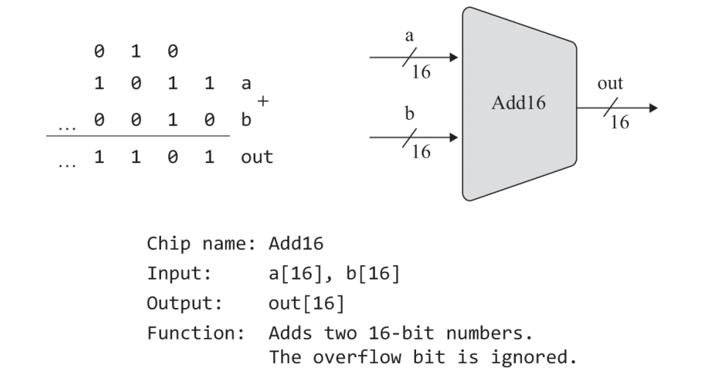
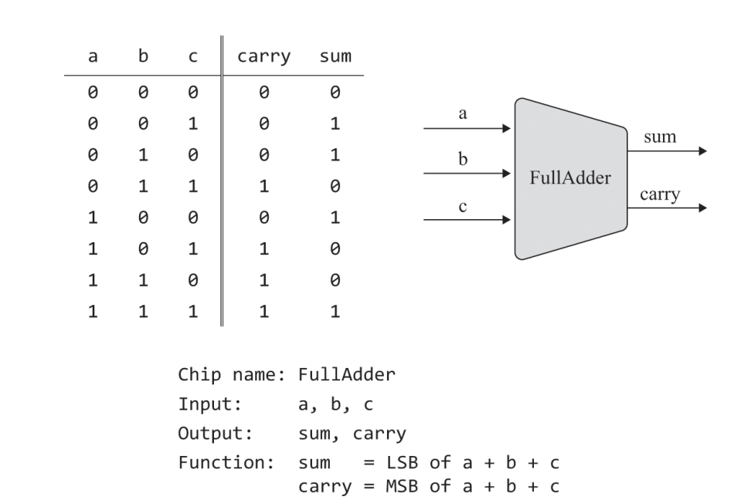
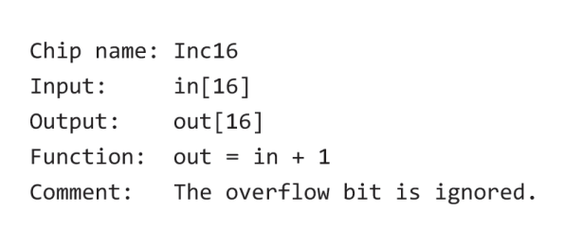
Boolean Logic

Slide 10
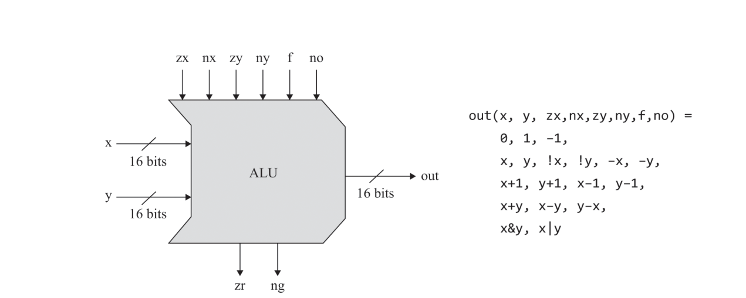
Boolean Logic
Arithmetic Logic Unit is a chip designed to compute a set of arithmetic and logic operations. the ALU will compute the set of eighteen arithmetic-logical functions.
Lets just ignore their functions for now!!!

Slide 11
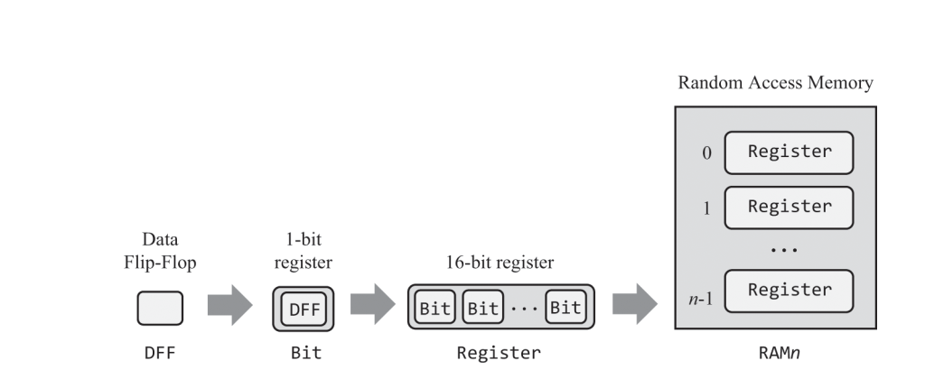
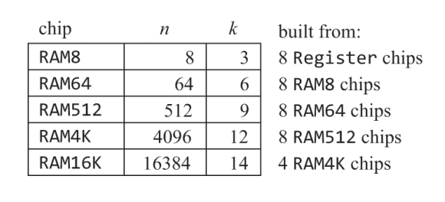
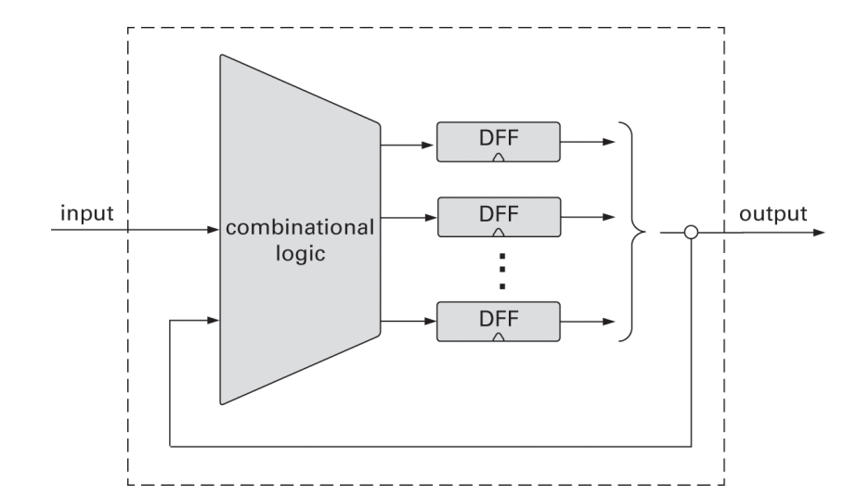
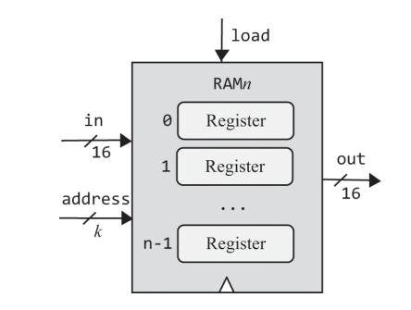
Memory

Slide 12
Introduction to Assembly Language

Slide 13
Agenda
Formal Introduction to the Regeisters and its types
Abstraction to Instruction
Types of Architectures
Opening the pendoras box (Register architectures)
Let’s write our first program
Memory models

